Slide 1
Regression Analysis
Simple Linear Regression
Nicoleta Serban, Ph.D.
Professor
School of Industrial and Systems Engineering
Regression Concepts:
Assumptions and Diagnostics

Slide 2

About This Lesson

Slide 3
Outliers in Regression
A data point far from the majority of the data (in y and/or x) may be called an outlier, especially if it does not follow the general trend of the rest of the data.
Data points that are far from the mean of the x’s are called leverage points.
A data point that is far from the mean of either or both the x’s and/or the y’s are influential points if they influence the fit of the regression.
An outlier may or may not impact the regression fit significantly, thus it may or may not be an influential point.
The upshot: Sometimes there are good reasons for excluding subsets (there were errors in the data entry; there were errors in the experiment). Sometimes - the outlier belongs in the data. Outliers should always be examined.

Slide 4
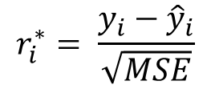
Checking for Outliers
Look at the standardized residuals:
$$r_{i}^{∗}= \frac{y_{i}−{\hat{y}}_{i}}{\sqrt{MSE}}$$
Compare the standardized residuals to the -2 to +2 band (or -1 to + 1).
Standardized residuals bigger than 1 are large.
Standardized residuals bigger than 2 extremely large.
Most statistics packages will calculate these automatically.

Slide 5
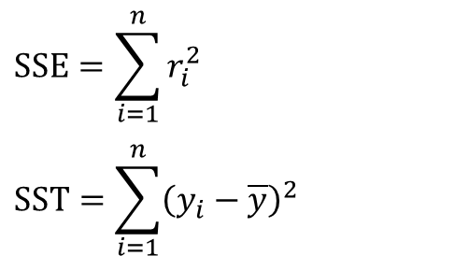
Coefficient of Determination
A statistic that efficiently summarizes how well the X’s can be used to predict Y is the R-square:
R² = 1 – SSE / SST
which is interpreted as:
R² = Proportion of total variability in Y that can be explained by the regression (that uses X)
$$SSE=\sum_{i=1}^{n}{r_{i}^{2}}$$
$$SST=\sum_{i=1}^{n}{{\left(y_{i}−\overline{y}\right)}^{2}}$$

Slide 6
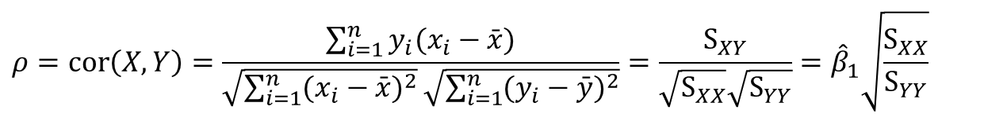
Correlation Coefficient
A statistic that efficiently summarizes how well the X’s are linearly related to Y is the correlation coefficient:
Correlation coefficient and coefficient of variation:
$$ρ=cor\left(X,Y\right)=\frac{\sum_{i=1}^{n}{y_{i}(x_{i}−\bar{x})}}{\sqrt{\sum_{i=1}^{n}{(x_{i}−\bar{x})^{2}}}\sqrt{\sum_{i=1}^{n}{(y_{i}−\bar{y})^{2}}}}=\frac{S_{XY}}{\sqrt{S_{XX}}\sqrt{S_{YY}}}={\hat{β}}_{1}\sqrt{\frac{S_{XX}}{S_{YY}}}$$

Slide 7

Summary

